Slide 1
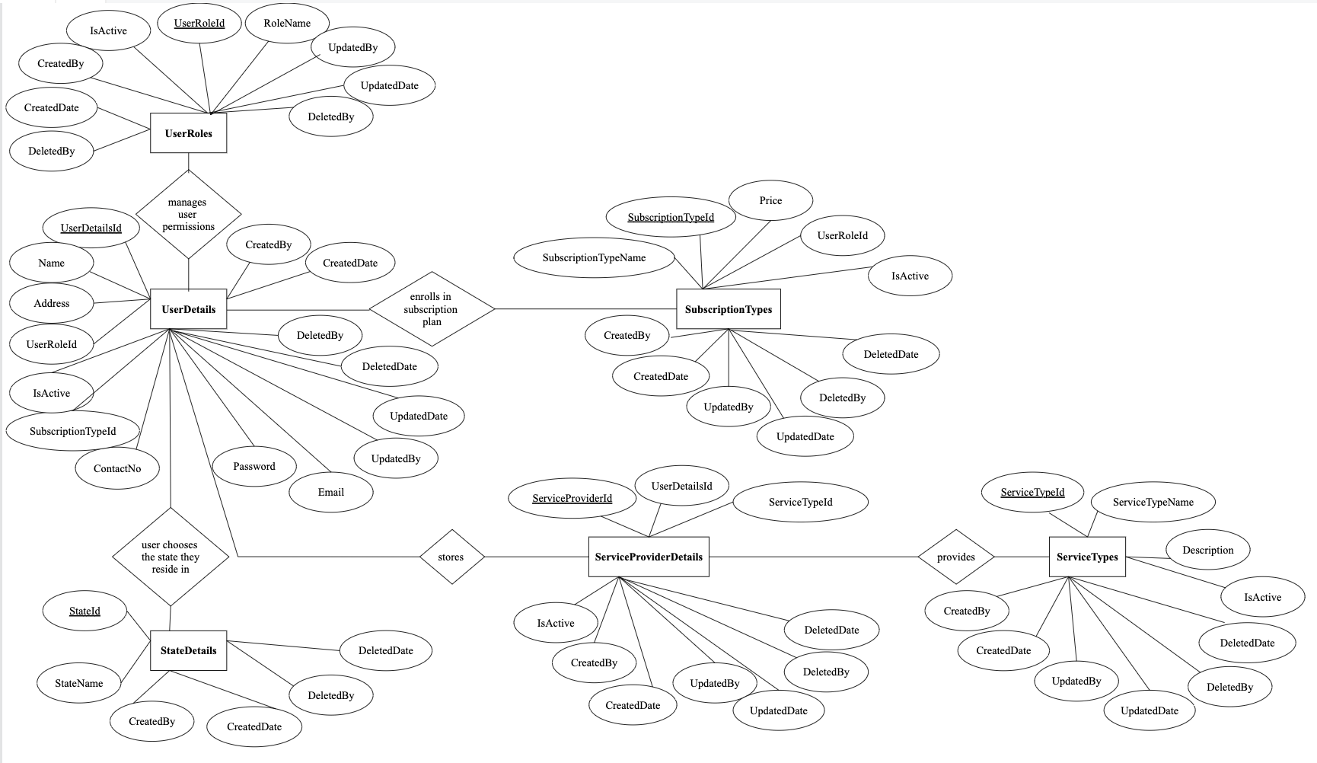
ER Diagram: MaidEase

Slide 2
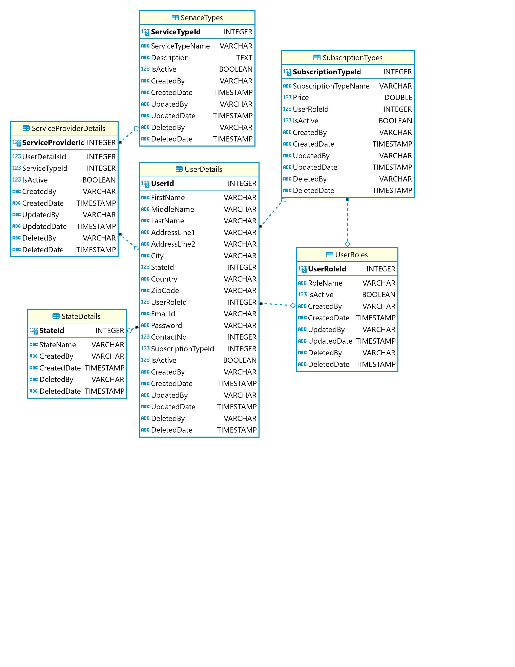
Logical Diagram: MaidEase

